Slide 1
Chapter 6
Network Layer – Part 1
Module 8: Network Later
Introduction to Networks v7.0 (ITN)

Slide 2
Objectives
6.1 Network Layer Protocols
6.2 Routing
6.3 Routers

Slide 3
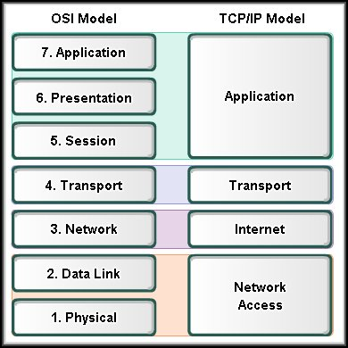
6.1 Network Layer Protocols

Slide 4

6.1.1 Network Layer
Handle end-to-end (source-to-destination) delivery
ROUTE and forward packets to DIFFERENT LANs or WANs according to their logical address

Slide 5
Cont’d…
To accomplish the end to end delivery / transport, the following four processes are involved:
(i) addressing – IP address
(ii) encapsulation - Packet
(iii) routing
(iv) de-encapsulation

Slide 6
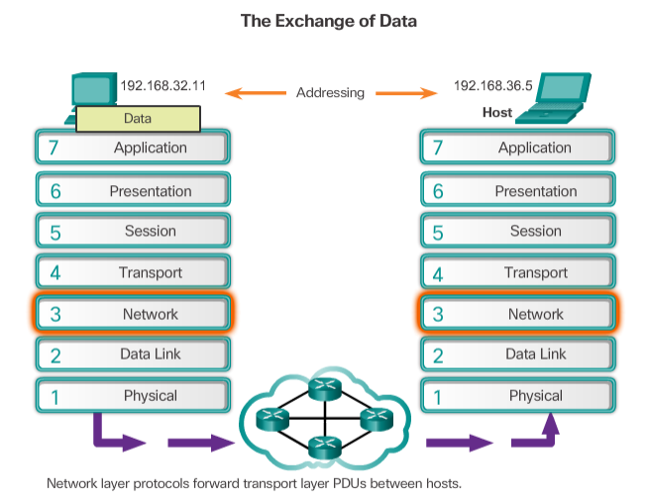
Data
Segment
Segment
hop
Packet
Packet
Frame
Frame
101010101
101010101
101010101

Slide 7
Cont’d…
Protocol(s) involved in this layer includes:
Internet Protocol version 4 (IPv4)
Internet Protocol version 6 (IPv6)
Novell Internetwork Packet Exchange (IPX)
AppleTalk
Connectionless Network Service (CLNS/DECNet)
(IP)

Slide 8
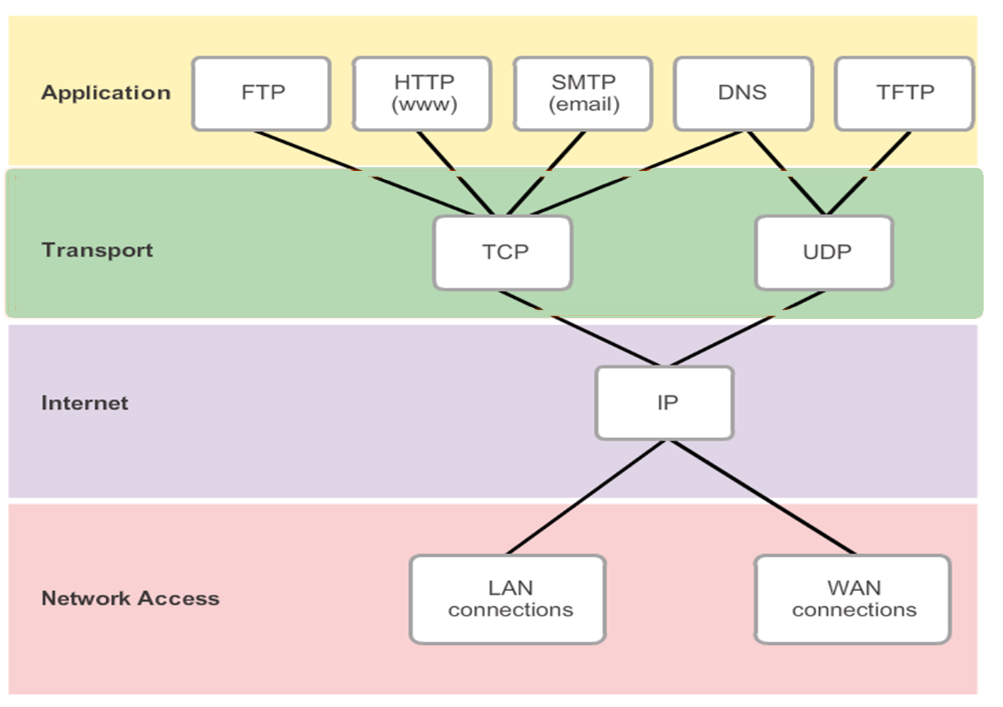

Slide 9
IPv4 vs IPv6
Internet Protocol Version 4 (IPv4) is the most widely deployed version of IP.
But due to IPv4 is “running out of addresses” Internet Protocol Version 6 (IPv6) is developed and slowly being implemented.
It is expected to eventually replace IPv4.
IPv6 has different characteristics than IPv4.

Slide 10
For your info…
The 32-bit IPv4 address space provides approximately 4,294,967,296 , or 4 billions (2³²) unique addresses. But, only 3.7 billion addresses are assignable.
IPv4 address has the following format: x . x . x . x
where x is called an octet and must be a decimal
value between 0 and 255.
Eg. 19.117.63.126

Slide 11
Cont’d…
While 128-bit IPv6 address space provides 340,282,366,920,938,463,463,374,607,431,768,211,456, or 340 undecillion (2¹²⁸) addresses, which is roughly equivalent to every grain of sand on Earth.
IPv6 address has the following format: y : y : y : y : y : y : y : y where y is called a segment (hextet) and each hextet stores 4 hex digits with the hexadecimal value between 0000 and FFFF.
Eg. 2001 : db8 : 3333 : 4444 : CCCC : DDDD : EEEE : FFFF

Slide 12
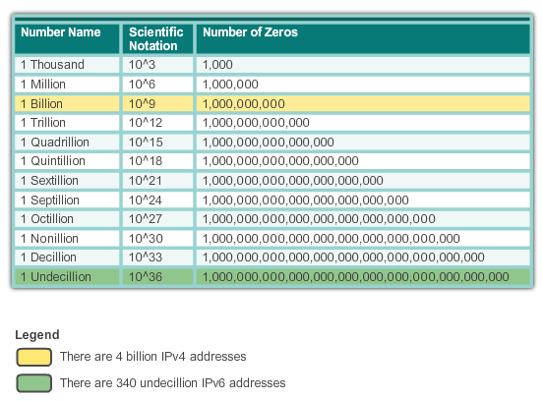

Slide 13
Characteristics of Internet Protocol (IP)
Connectionless
Use “Best Effort” service
Media Independent

Slide 14
1. Connectionless
No communication session is established prior (before) to the data transmission
This process greatly reduces the overhead of IP.
However, with no pre-established communication session, the sender is unaware whether the receiver is present and functional, nor if the destination receives the packet.

Slide 15
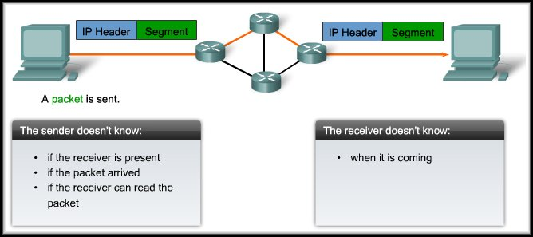

Slide 16
2. Use “Best Effort” service
Unreliable delivery
does not provide any guarantees that data is delivered properly (ie. packets may lost or out-of-sequence)
does not provide any special features that recover lost or corrupted packets.
Since IP does not manage reliability, IP is allowed to function very efficiently at the Network Layer → minimal burden

Slide 17
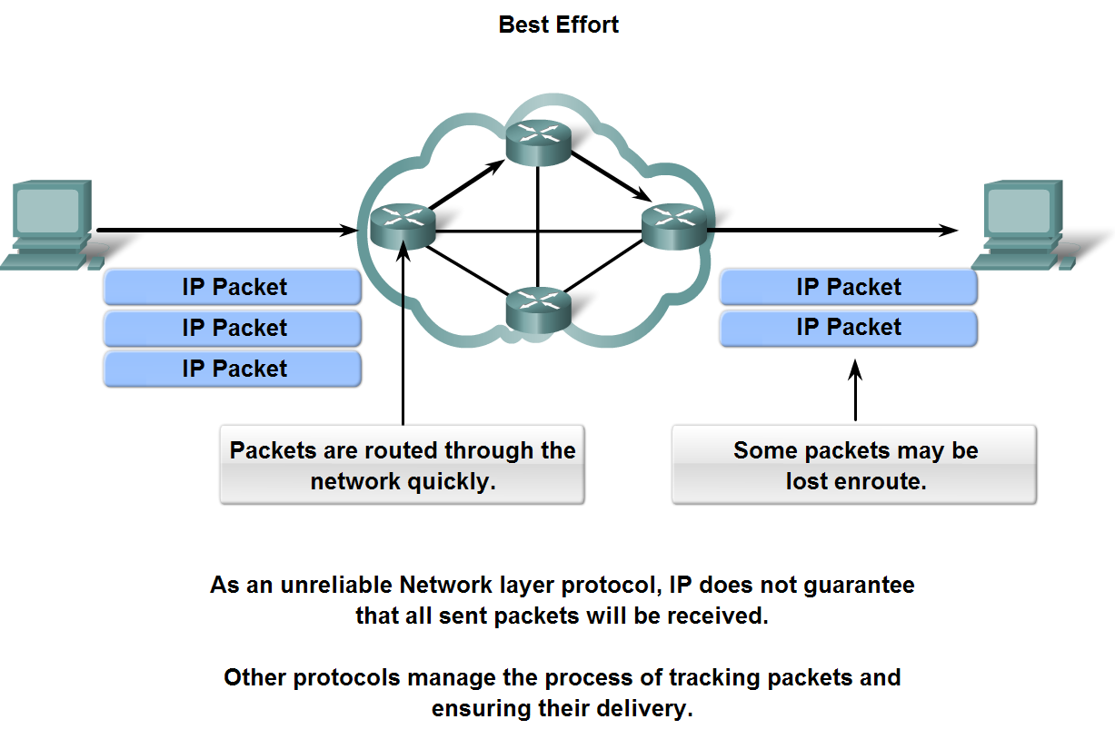

Slide 18
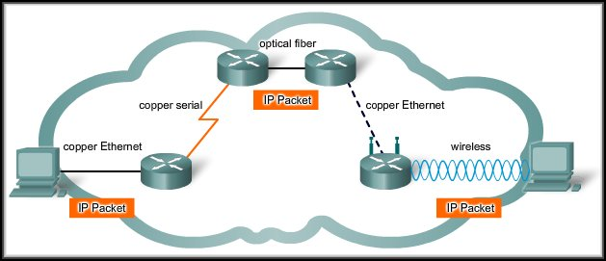
3. Media Independent
Not concerned with the physical medium that data used to transmit
The transport of IP packets is not limited to any particular medium.

Slide 19
Cont’d…
But, it is concern with the max size of the packet (in byte) that each media (network) can send → Maximum Transmission Unit (MTU)
Different media (network) has different MTU.
Any messages larger than the MTU are divided into smaller packets before being sent.
When packet moves from one media (which is of higher MTU) to another (which is of lower MTU), the intermediary router will need to split up a packet to a smaller MTU → fragmentation

Slide 20

Cont’d…
Copper Ethernet: MTU = 1,518 bytes
Copper Serial: Frame Relay MTU = 512 bytes
Optical Fiber: ATM MTU = 17,966 bytes
Wireless: 802.11 MTU = 2272 bytes.
512 bytes
1,518 bytes

Slide 21
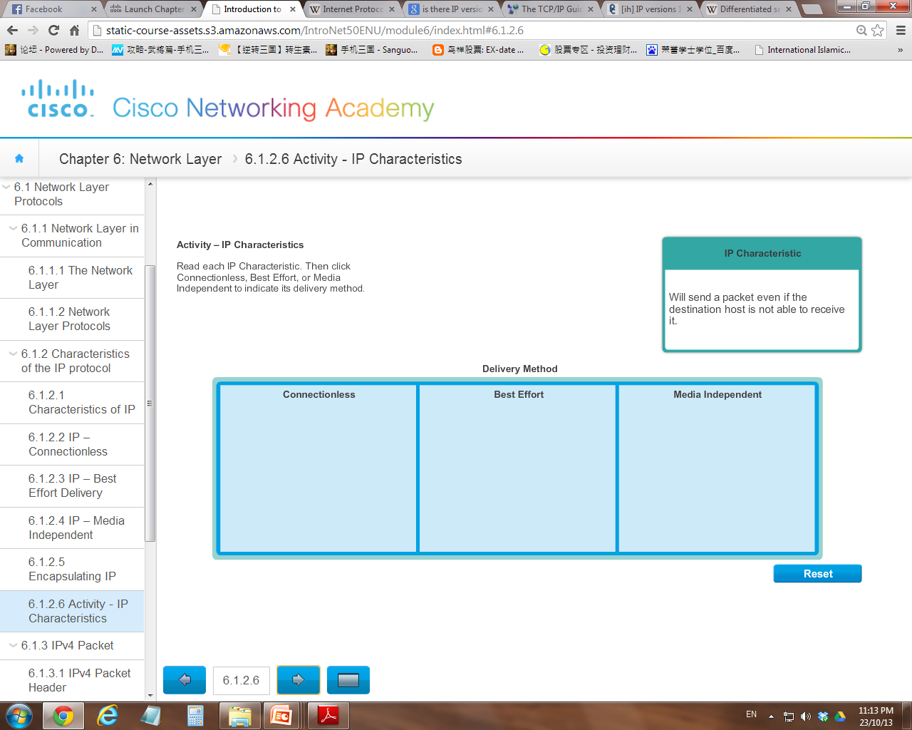
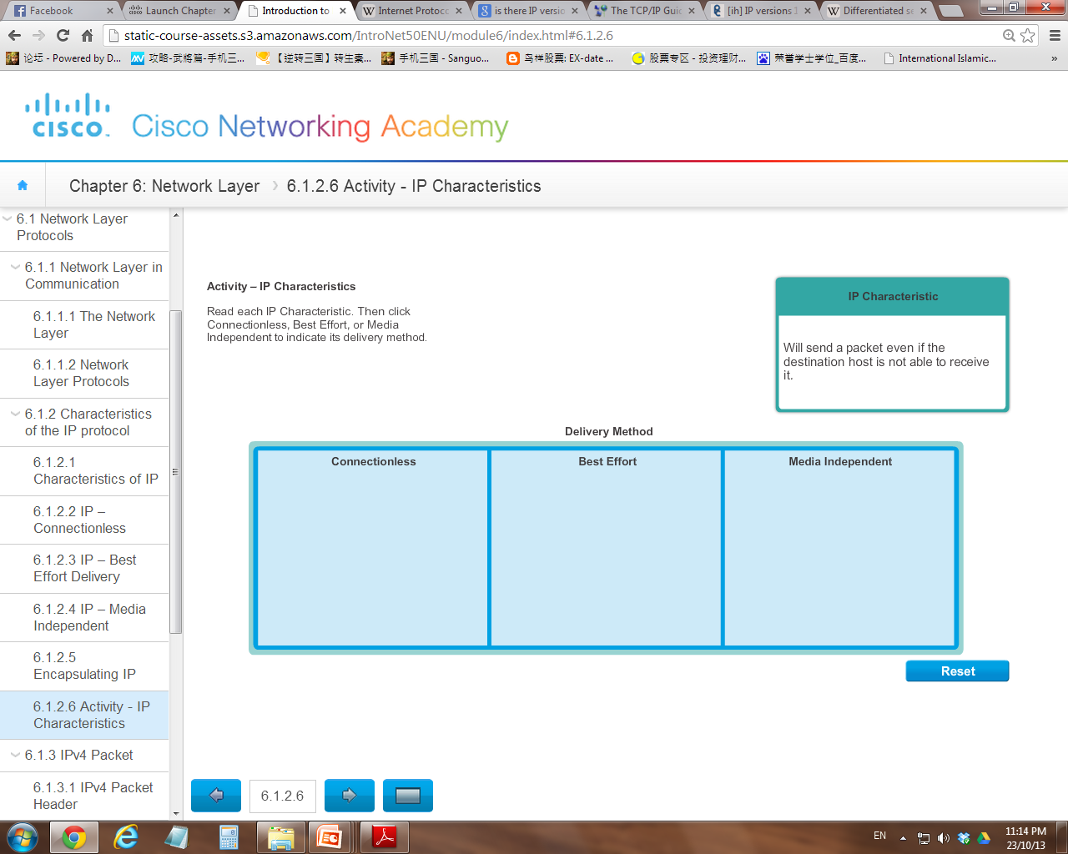
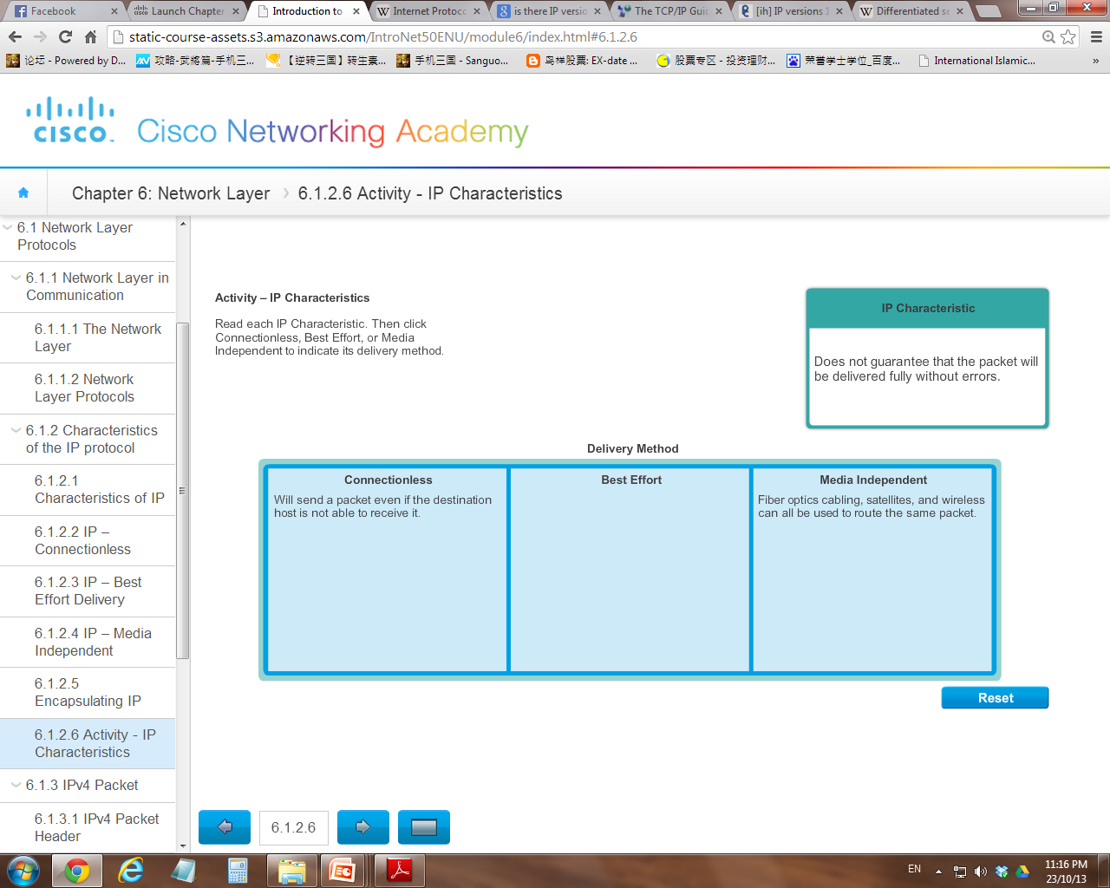
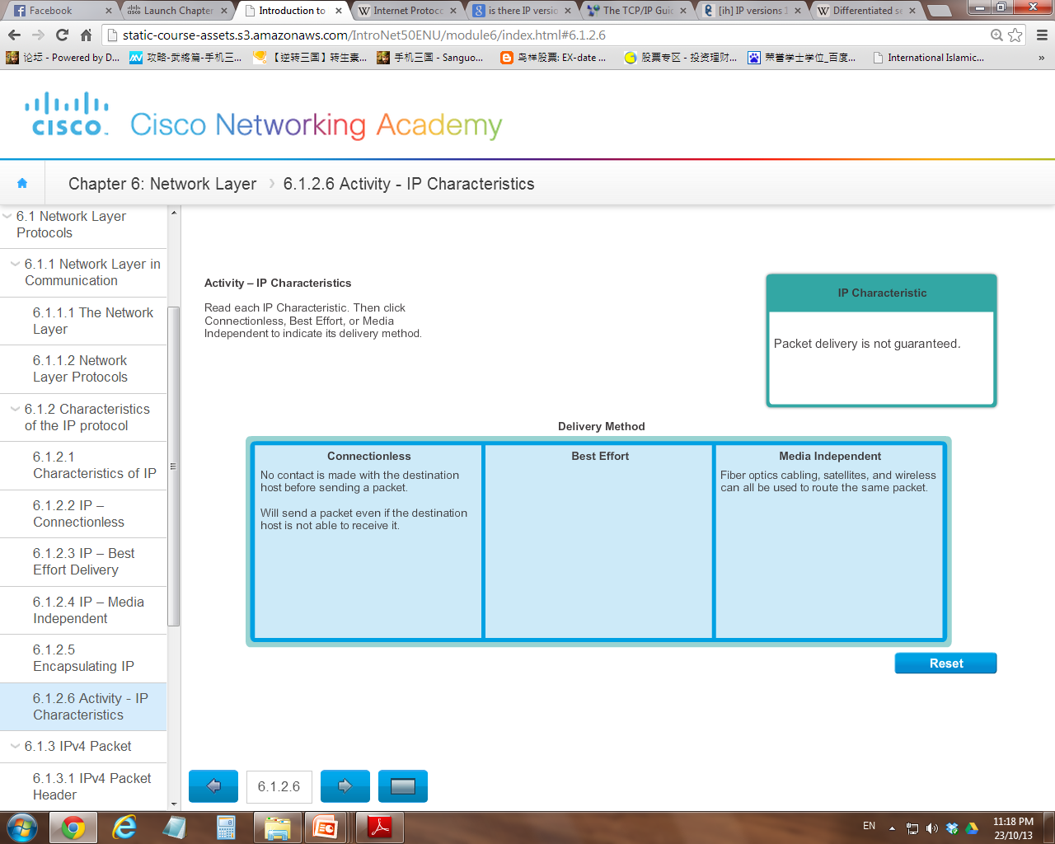
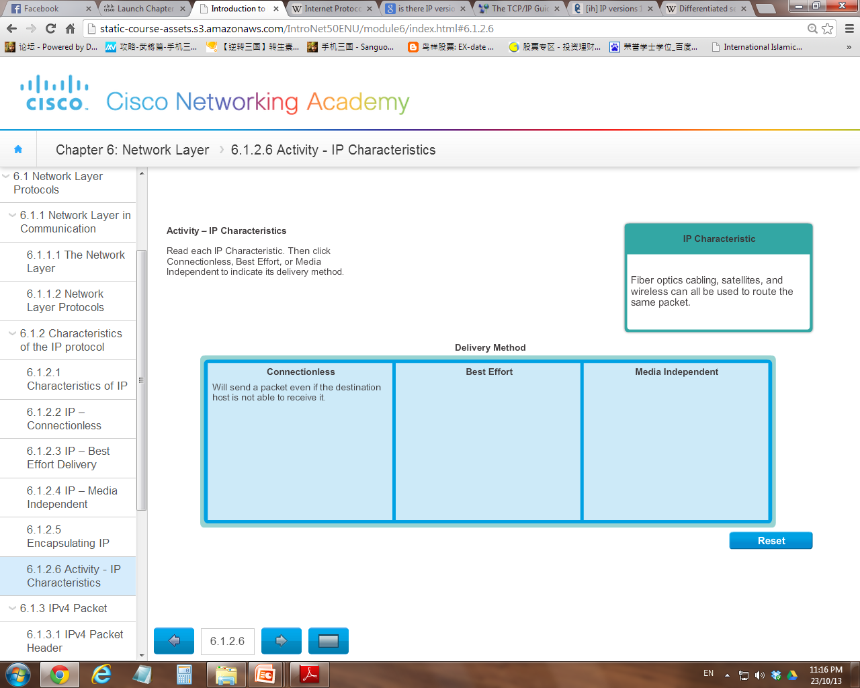


Review Question

Slide 22
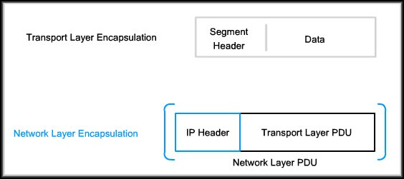
Encapsulation in Network Layer
The Transport Layer segment is encapsulated with IP Header at the network Layer
→ Packet

Slide 23
6.1.2 IPv4 Packet
An IPv4 packet has two parts:
IP Header - Identifies the packet characteristics.
Payload - Contains the Layer 4 segment information and the actual data.

Slide 24
Cont’d…
IP Header
Payload
IPv4 Packet

Slide 25

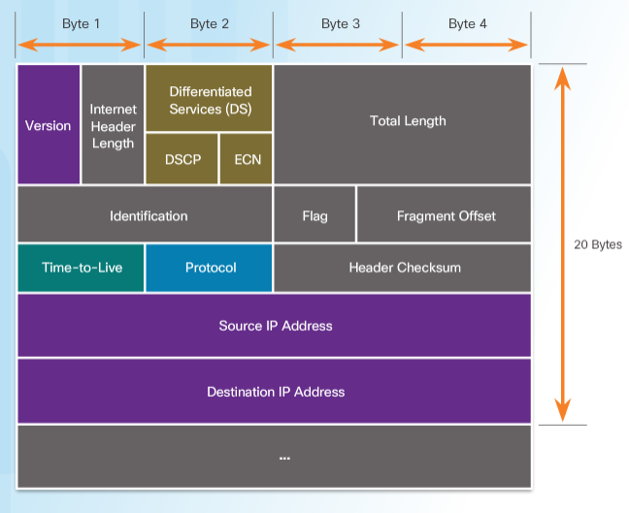
IPv4 Header

Slide 26
Cont’d…
Significant fields in the IPv4 header include:
Version - Identify the IP packet version. (IPv4 is always set to 0100)
Differentiated Services (DS) - Used in classification purpose and determine the priority of each packet and services to apply
Time-to-Live (TTL) - Used to limit the lifetime of a packet to prevent infinity hop. Commonly referred to as hop count.

Slide 27
Cont’d…
Protocol - indicates the data payload type that the packet is carrying, which enables the network layer to pass the data to the appropriate upper-layer protocol. Eg. ICMP, TCP, and UDP.
Source IP Address - Represents the source IP address of the packet.
Destination IP Address - Represents the destination IP address of the packet.

Slide 28
Limitations of IPv4
IP Address depletion
IPv4 has a limited number of unique public IPv4 addresses available and are using up.
Internet routing table expansion
As more devices and servers are connected to the network, more routes are created. A large number of routes can slow down a router. IPv4 header is not as effective as IPv6
Lack of end-to-end connectivity
Devices share single public IPv4 address (using NAT technique) when connecting to the internet, this can be problematic for technologies that require end-to-end connectivity.

Slide 29
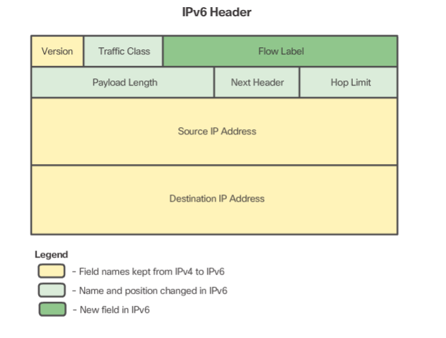
6.1.3 IPv6 Packet

Slide 30
Cont’d…
The fields in the IPv6 packet header include:
Version - identifies this as an IP version 6 packet (IPv6 is 0110).
Traffic Class - Equivalent to the IPv4 Differentiated Services (DS) field.
Flow Label - used to indicate a set of packets belonging to the same flow and should be handled in a similar fashion
Payload Length - Indicates the length of the data portion or payload of the IPv6 packet.

Slide 31
Cont’d…
Next Header - Equivalent to the IPv4 Protocol field.
Hop Limit - Replaces the IPv4 TTL field.
Source Address - Identifies the IPv6 address of the sending host.
Destination Address - Identifies the IPv6 address of the receiving host.

Slide 32
Advantages of IPv6
Improvements that IPv6 provides include:
Increased address space
IPv6 addresses are based on 128-bit hierarchical addressing as opposed to IPv4 with 32 bits (4 Billions vs 340 Undecillion)
Improved packet handling
The IPv6 header has been simplified with fewer fields (less overhead)
Eliminates the need for NAT
With such a large number of public IPv6 addresses, NAT between a private IPv4 address and a public IPv4 is not needed.

Slide 33
6.2 Routing
If a host sends a packet to a device in the SAME network, the packet is simply forwarded to the destination device directly using the MAC address (after referring to its Host Routing Table)
When a host sends a packet to a REMOTE destination device, then the help of Routers and routing is needed.
A host just need to know the address of other hosts of the SAME network (other local hosts). A host device does not maintain routing information beyond the local network.
The Default Gateway (Router) does → Router Routing Table

Slide 34
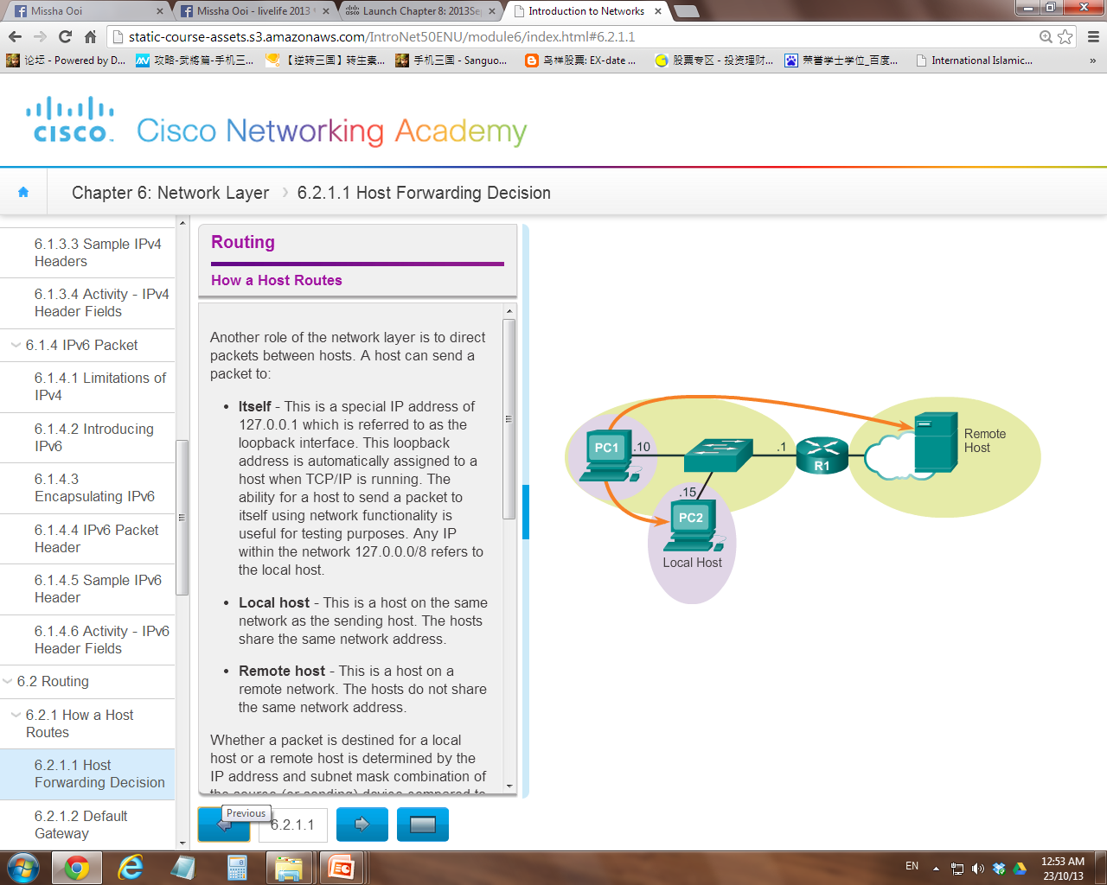
Router Routing Table
Host Routing Table

Slide 35
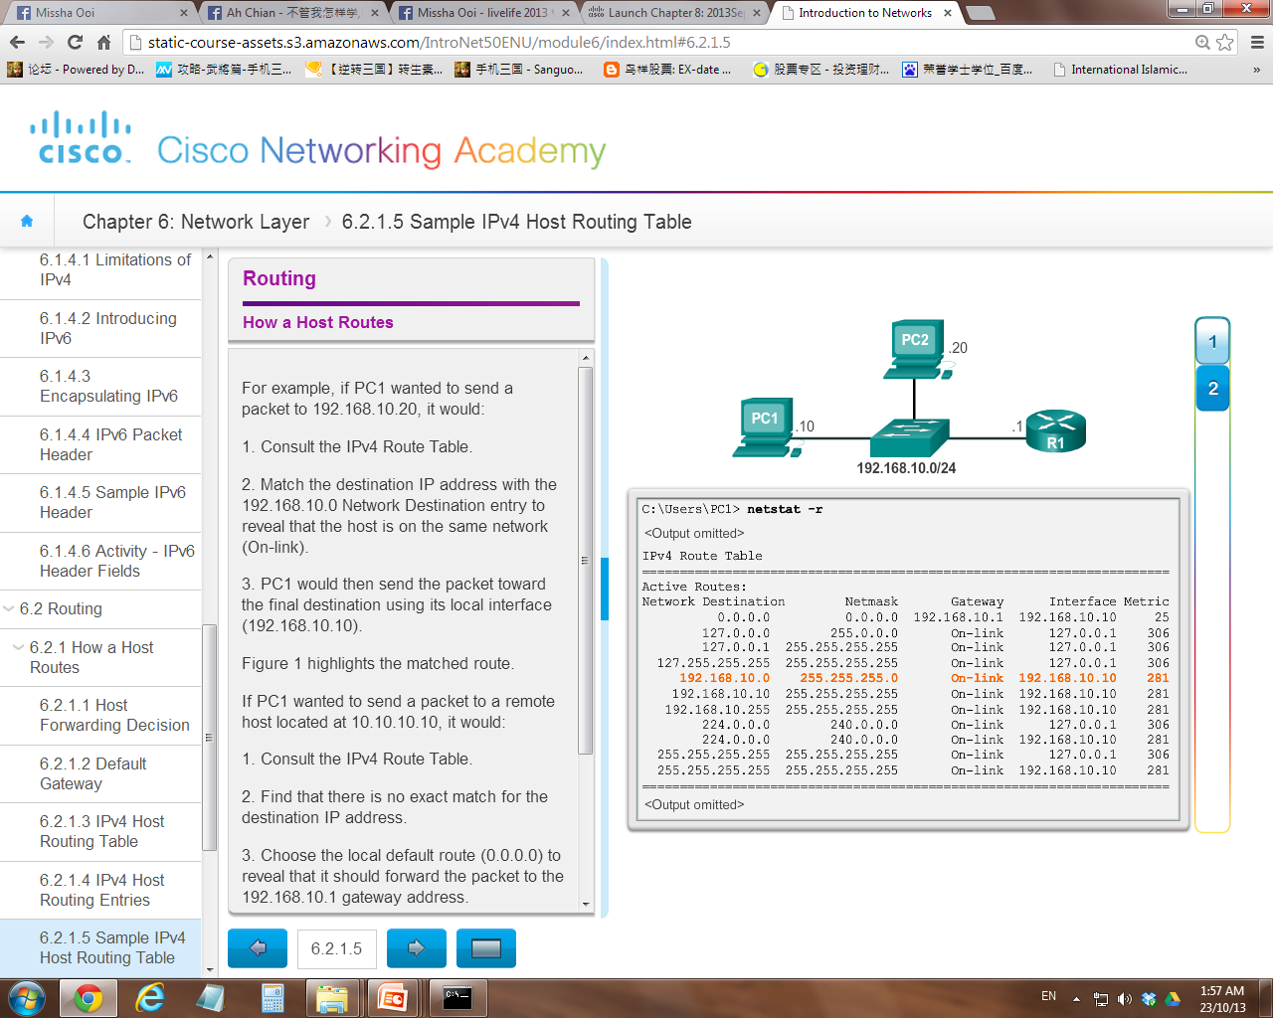
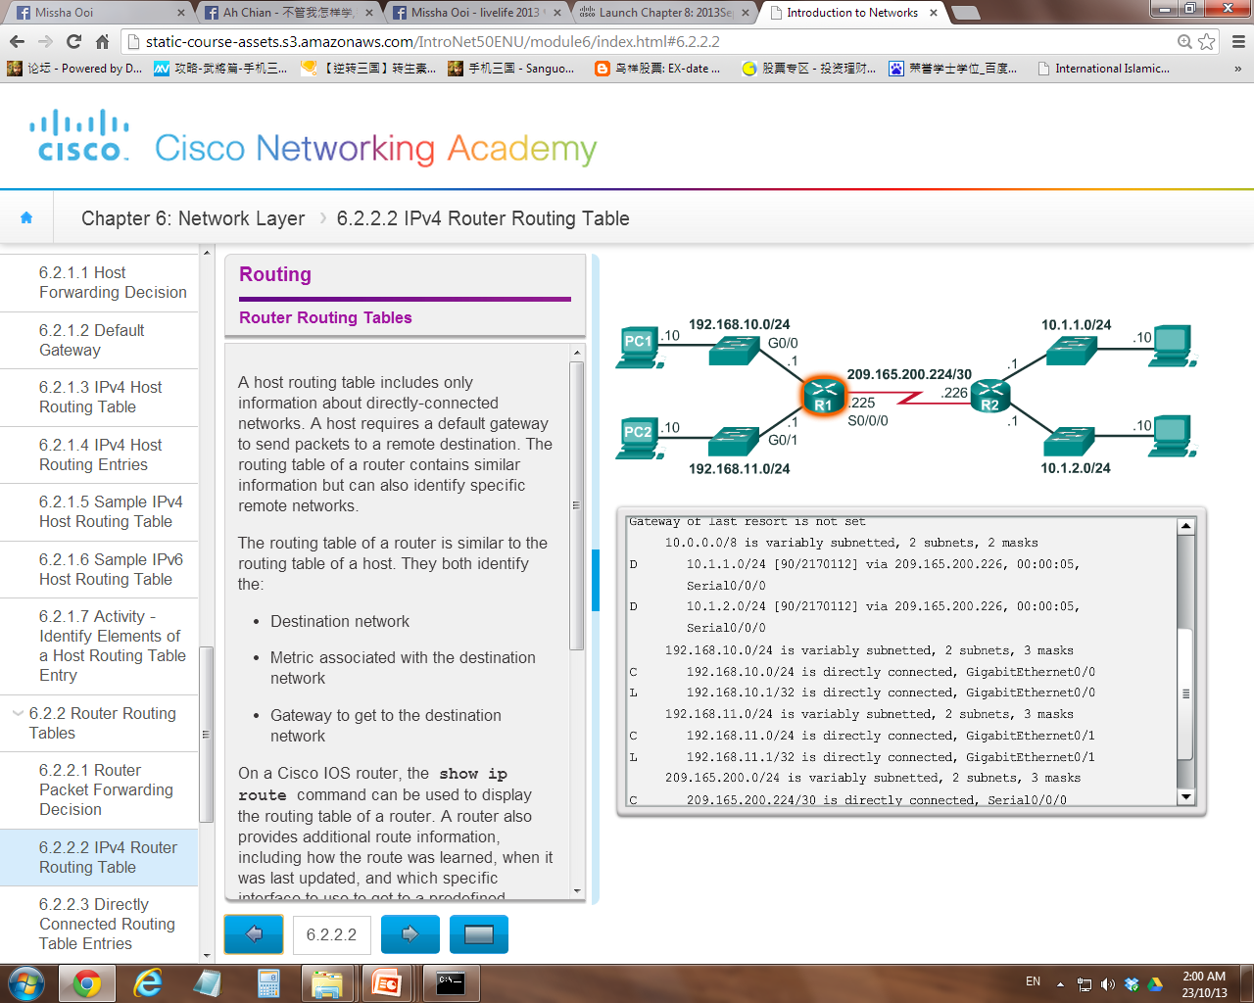
Host Routing Table
netstat -r
Router Routing Table
show ip route

Slide 36
Default Gateway
The default gateway is the device that routes traffic from the local network to devices on remote networks.
The default gateway maintains a routing table that consists of information about:
Directly connected network
Remote networks that learn from other router
A router uses the information in the routing table to forward the packets.
When there are more than one possible routes, it will determine the best path to reach those destinations.

Slide 37
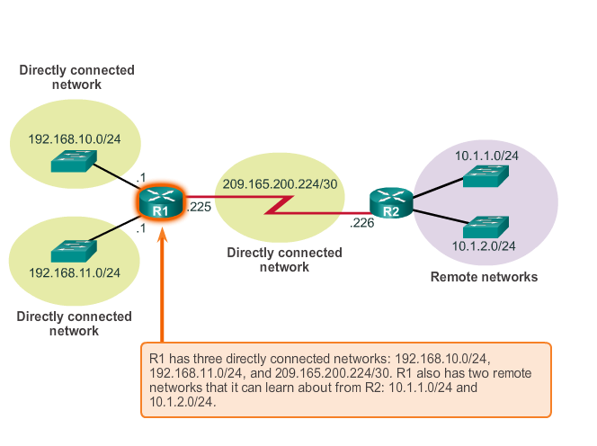
Directly connected networks
Remote networks

Slide 38
Scenario 1
PC1 wanted to send a packet to 192.168.10.20
Consult Host Routing Table
Found match recorded (same network)
Forward directly using the MAC address
Host Routing Table

Slide 39
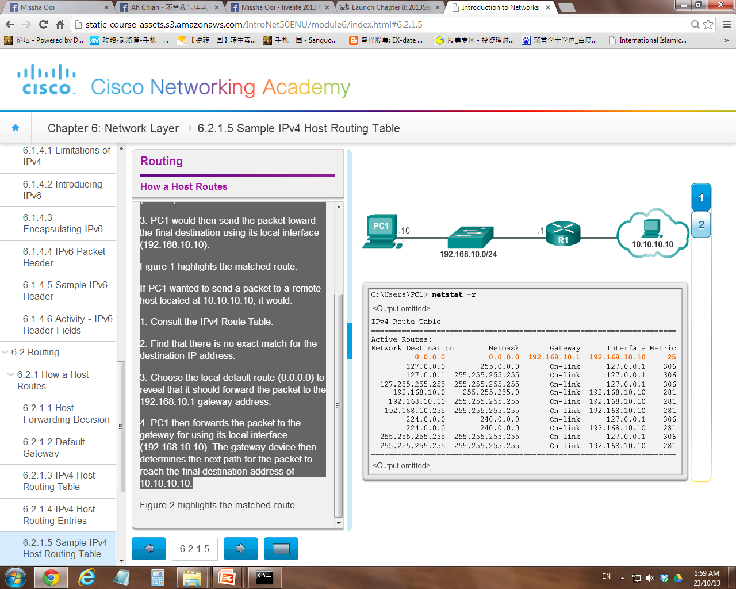
Scenario 2
Consult Host Routing Table
Found no match recorded (remote network)
Send to default route (0.0.0.0)
Send packet to the gateway (192.168.10.1) using the interface (192.168.10.10)
Router then forward the packet to the remote network using best path
PC1 wanted to send a packet to a remote host located at 10.10.10.10
Host Routing Table

Slide 40
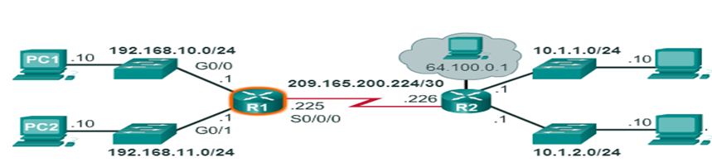
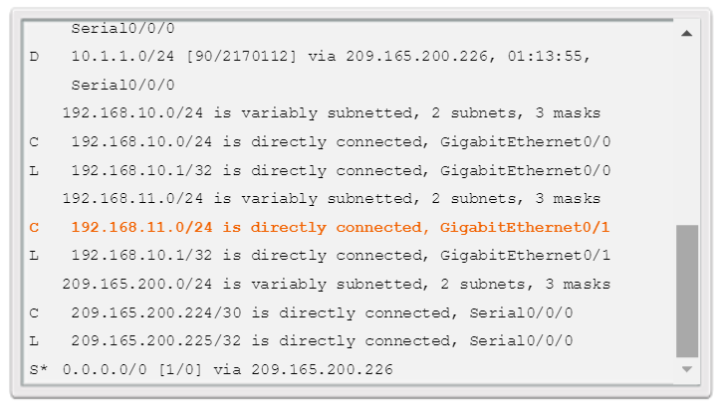
Scenario 3
PC1 wants to send a packet to 192.168.11.10
What will PC1 do in the first step?
Check the Host Routing Table
Will the destination network be found (matched) in the table?
No
What will happen next?
It will use the local default route 0.0.0.0 to forward the packet to the gateway
(192.168.10.1)
Router Routing Table

Slide 41
Directly Connected Routing Table Entries
192.168.10.0/24
64.100.0.1
10.1.1.0/24
PC1
.10
G0/0
.1
209.165.200.224 /30
.10
.1
R1
.225
S0/0/0
.226
R2
.10
.1
G0/1
.1
.10
PC2
192.168.11.0/24
10.1.2.0/24
A
B
C
C 192.168.10.0/24 is directly connected, GigabitEthernet0/0
L 192.168.10.1/32 is directly connected, GigabitEthernet0/0
A | Identifies how the network was learned by the router.
B | Identifies the destination network and how it is connected.
C | Identifies the interface on the router connected to the destination network. (exit interface)

Slide 42
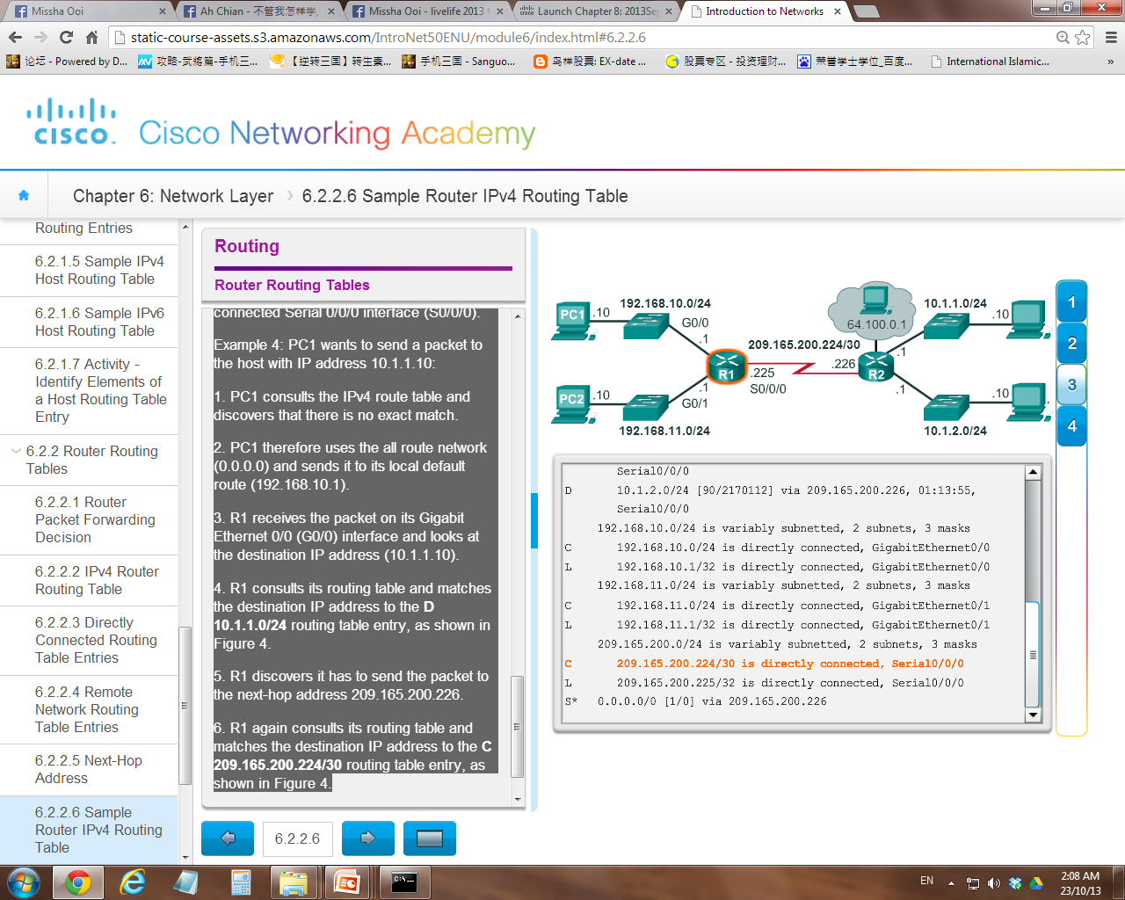
Scenario 4
PC1 wants to send a packet to 209.165.200.226
What will PC1 do in the first step?
Check the Host Routing Table
Will the destination network be found (matched) in the table?
No
What will happen next?
It will use the local default route 0.0.0.0 to forward the packet to the gateway
(192.168.10.1)
Router Routing Table

Slide 43
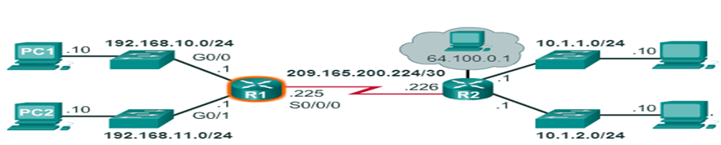

Scenario 5
PC1 wants to send a packet to 10.1.1.10
Next hop address
Router Routing Table

Slide 44
Remote Network Routing Table Entries
192.168.10.0/24
64.100.0.1
10.1.1.0/24
PC1
.10
G0/0
.1
209.165.200.224 /30
.10
.1
R1
.225
S0/0/0
.226
R2
.10
.1
G0/1
.1
.10
PC2
192.168.11.0/24
10.1.2.0/24
D 10.1.1.0/24 [90/2170112] via 209.165.200.226, 00:00:05, Serial0/0/0
A | Identifies how the network was learned by the router.
B | Identifies the destination network.
C | Identifies the administrative distance (trustworthiness) of the route source.
D | Identifies the metric to reach the remote network.
E | Identifies the next hop IP address to reach the remote network.
F | Identifies the amount of elapsed time since the network was discovered.
G | Identifies the outgoing interface on the router to reach the destination network.

Slide 45
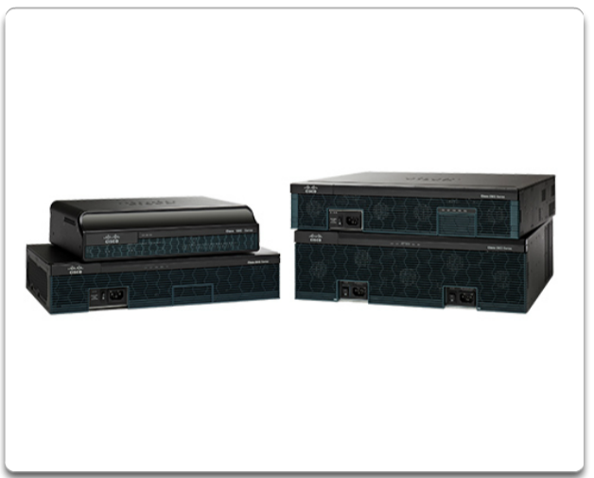
6.3 Router
Routers are devices that connect multiple computer networks together via either wired or wireless connections.
A router is a Layer 3 network gateway device that operates at the Network Layer of the OSI model.
Regardless of their function, size or complexity, all router models are essentially computers.
Just like computers, tablets, and smart devices, routers also require:
Central processing units (CPU)
Operating systems (OS)
Memory consisting of random-access memory (RAM), read-only memory (ROM), nonvolatile random-access memory (NVRAM), and flash.

Slide 46
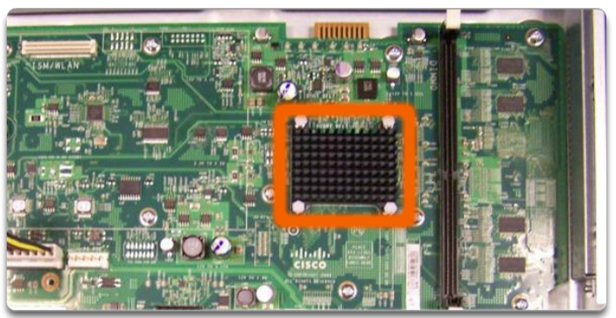
Cont’d…
Router CPU
Used to execute OS instructions, such as system initialization, routing functions, and switching functions.
Router OS
The Cisco Internetwork Operating System (IOS) provide routing and switching functions

Slide 47
Cont’d…
Memory | Volatile / Non-Volatile | Stores
RAM | Volatile | Running IOS Running configuration file IP routing and ARP tables Packet buffer
ROM | Non-Volatile | Bootup (startup) instructions Basic diagnostic software Limited IOS
NVRAM | Non-Volatile | Startup configuration file
Flash | Non-Volatile | IOS Other system files

Slide 48
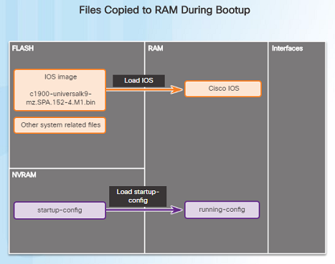
Router Boot-up Bootset Files
Cisco routers and switches load the IOS image and Startup Configuration File into RAM when they are booted.
The Running Configuration is modified when the network administrator makes any changes. These changes should be saved to the Startup Configuration File in NVRAM in order for them to take effect on the next reboot of the router or during in the event of a power loss.

Slide 49
Chapter Summary
Roles of the Network Layer
Examine Internet Protocol (IP) and its features
3 characteristics of IP
How routing works
Router

